Slide 1

Masters Program
Department of Computing Science
Automated Threat Detection In X-Ray Imagery For Advanced Security Applications
Presentation

Slide 2
Harmful Object Detection : XRay Images
Limited Dataset
Accuracy Improvement
Speed Improvement

Slide 3
Limited Dataset &
X-Ray Images differs from normal Images
Popular Datasets available For Training mostly contains only 4 classes of Objects: Knife, Razor/Blade, Shuriken and Gun. But actual machines used at site need to identify more than 12 classes of objects : Gun, Knife, Bomb, Scissor, Blade, Spanner, Tools, GunParts, Mobile, BatteryBank, Charger, Battery etc. Each of these classes can have different object types and orientations

Slide 4
Limited Data : Normal Data Augmentations
Synthetic Image Generation
Guns
Shuriken
The good, the bad and the ugly: Evaluating ….. synthetically composited X-ray imagery

Slide 5
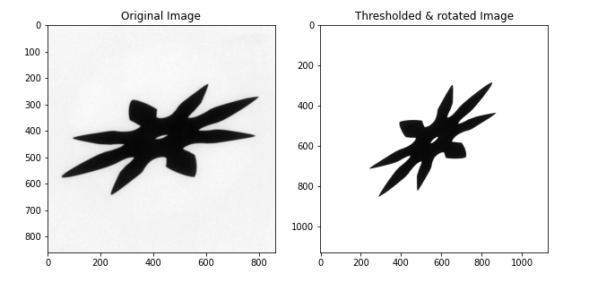
Synthetic Image Generation
1. Threat Signature Transformation

Slide 6
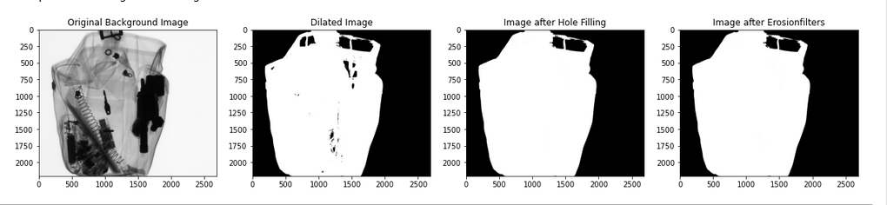
Synthetic Image Generation
2. Image position determination

Slide 7
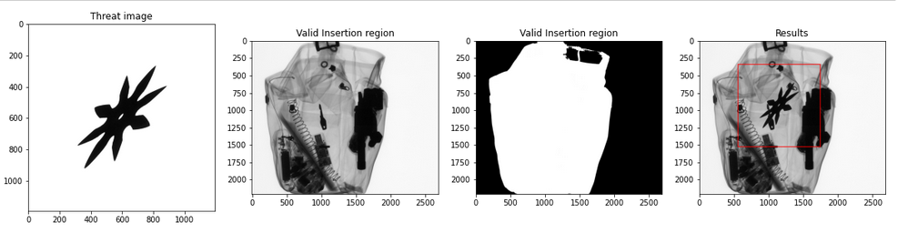
Synthetic Image Generation
3. Image compositing

Slide 8
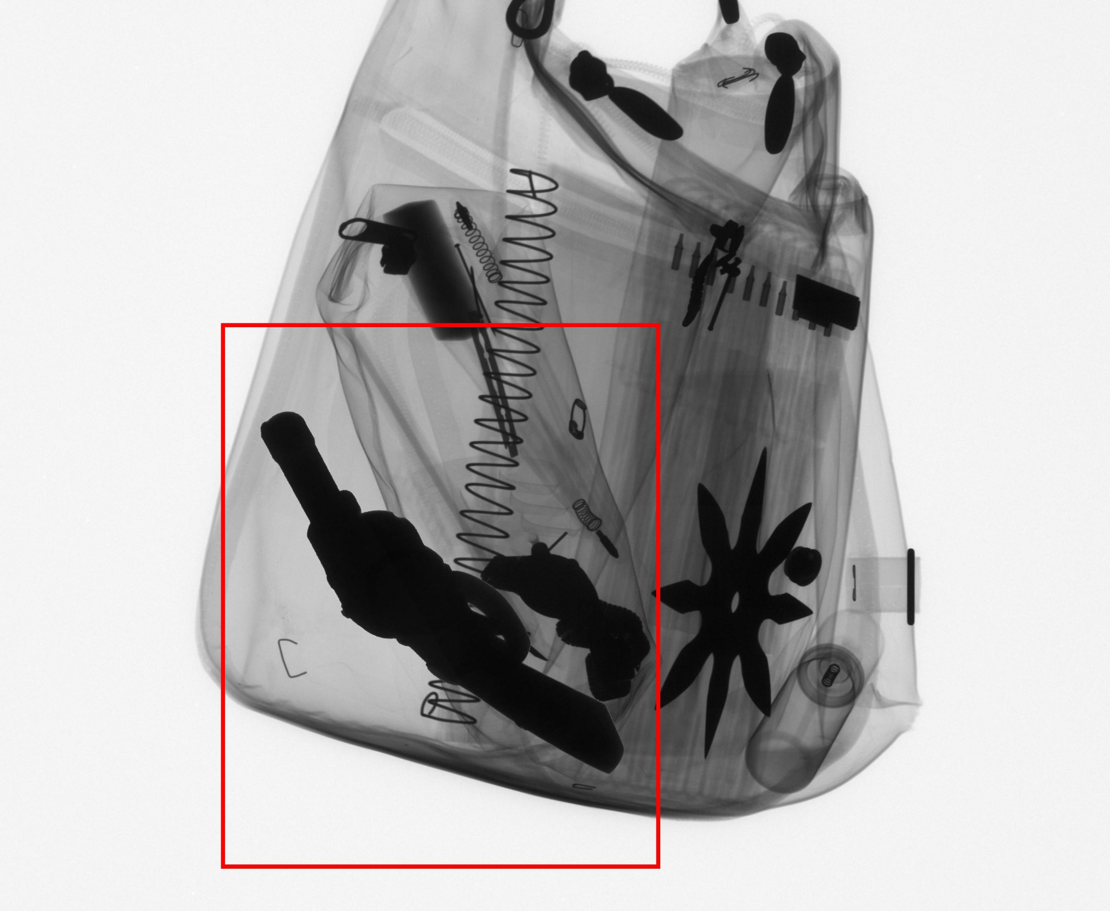
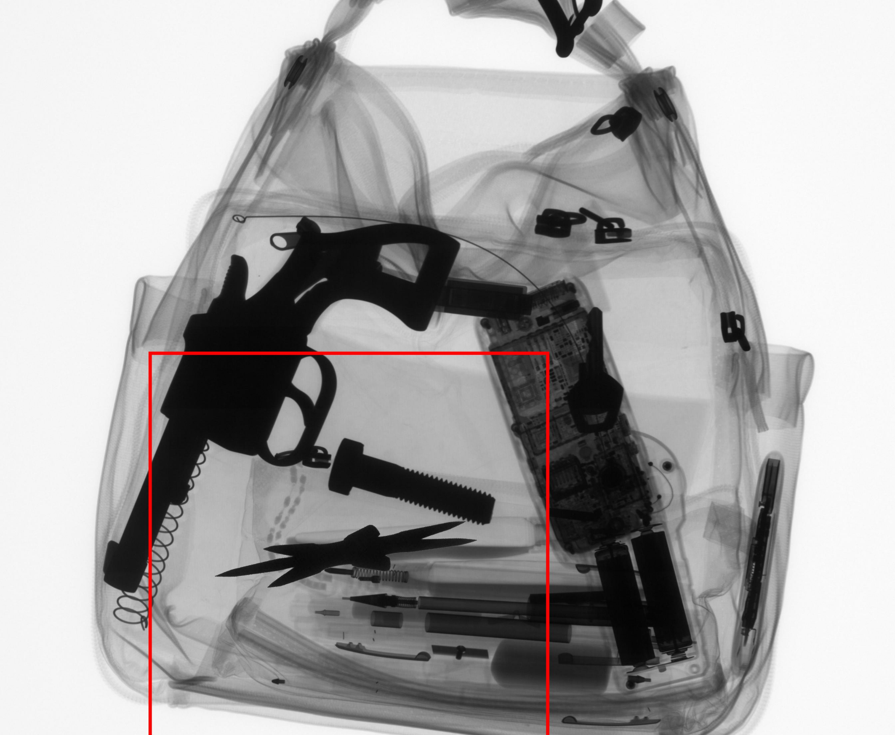
Sample Results

Slide 9
https://www.researchgate.net/publication/340893960_YOLO_v3-Tiny_Object_Detection_and_Recognition_using_one_stage_improved_model
Modelling : Yolov3-tiny
Decreased depth of the convolutional layer in Yolov3
10 times Faster than Yolov3, provides low accuracies

Slide 10
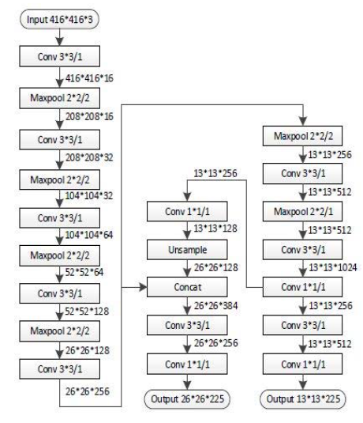
https://www.researchgate.net/publication/340893960_YOLO_v3-Tiny_Object_Detection_and_Recognition_using_one_stage_improved_model
Architecture : Yolov3-tiny
Prediction of bounding boxes occurs at two different feature
map scales, which are 13×13, and 26×26 merged with an upsampled 13×13 feature map.

Slide 11
Choose & Label Dataset for training :
`Set | GDXRay | Baggage Data
Training | Series | B0046
 | Images | 1-200
 | Series | B0047
 | Images | 1-10
Testing | Series | B0047
 | Images | 11-90
Real Data [GDXRay] : 210 Training Data & 90 Testing Data
Synthetic Data : 1600 Training Data & 400 Testing Data

Slide 12
Results of Real Dataset :
Classes | Testing Accuracy (mAP)
 | Real Model(on Real Dataset) | Synthetic Modell(on Real Dataset)
Guns | 93.59 | 79.26
Shuriken | 86.59 | 12.37

Slide 13
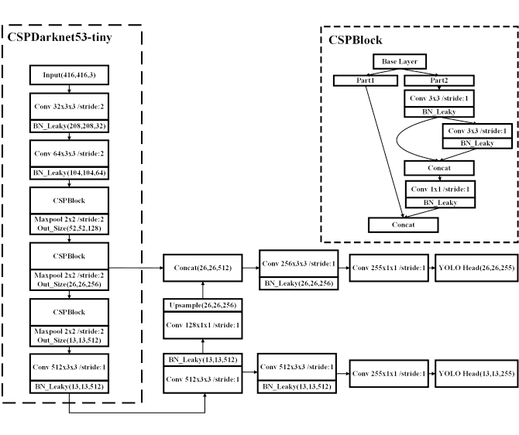
Yolov4 Architecture :

Slide 14
Accurracy & Speed Improvement : Model Comparision
Transfer Learning : Using Pre-Trained Weights and fine tune the model.
Batch & Subdivision - Control no of images to be send for processing. Appropriate number can improve GPU utilization.
Reduce no of filters in architecture as we need less no of classes (5+classes)*3
Check model is trained properly using the graph
Save the weights after several iterations, we are saving after every 1000 iterations.

Slide 15
The Yolov4-tiny method uses CSPDarknet53-tiny network as backbone network which uses CSPBlock module in cross stage partial network instead of the ResBlock module in residual network.
The CSPBlock module divides the feature map into two parts, and combines the two parts by cross stage residual edge. This makes the gradient flow can propagate in two different network paths to increase the correlation difference of gradient information. The CSPBlock module can enhance the learning ability of convolution network comparing with ResBlock module. Although this increase computation by 10%-20%, it improves the accuracy.
To reduce the amount of calculation, it removes the computational bottlenecks that have higher amount of calculation in CSPBlock module. It improves the accuracy of Yolov4-tiny method in the case of constant or even reduced computation.

Slide 16
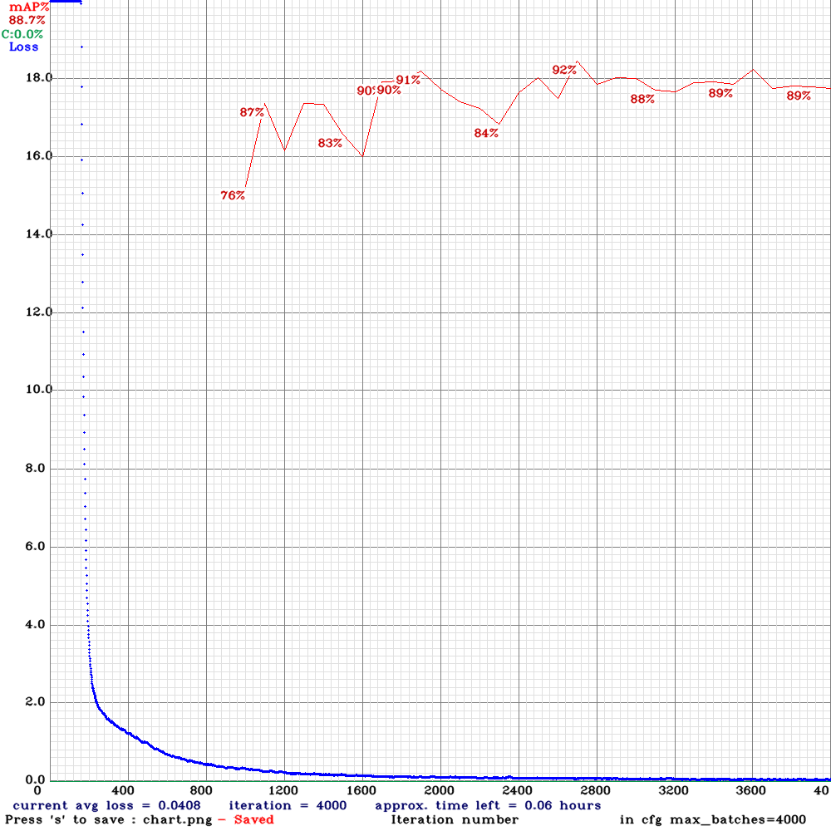
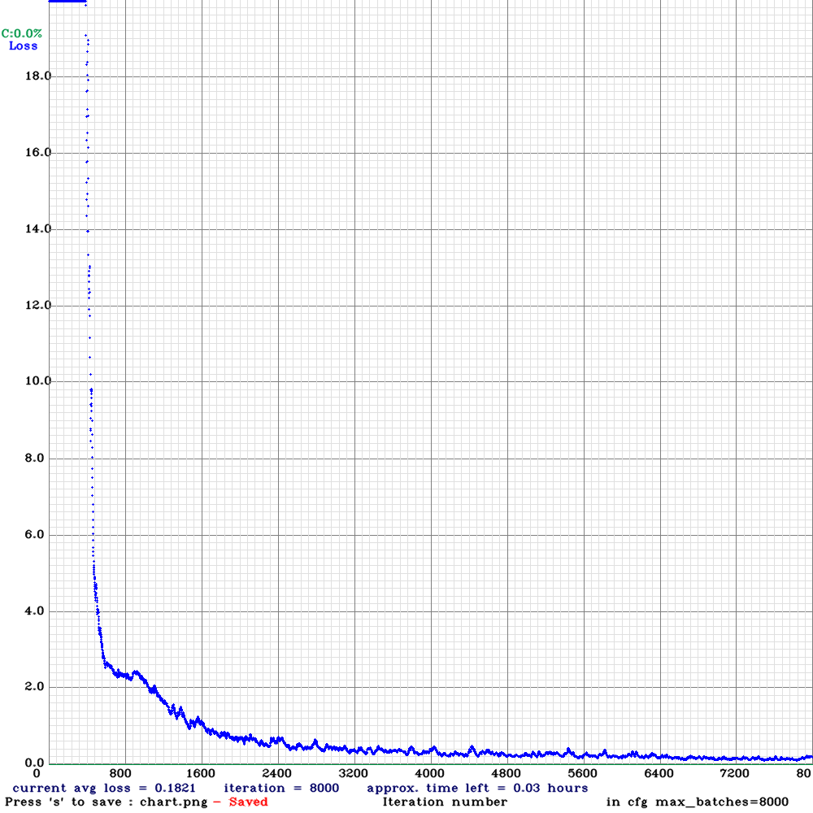
Training Graphs :

Slide 17
Comparison Metrics : IOU = 50%
MODEL | YOLOV3-Tiny | YOLOV4-Tiny
Gun (AP) | 93.59 | 96.95
Knife (AP) | 94.82 | 93.95
Razor (AP) | 55.05 | 84.62
Shuriken (AP) | 86.59 | 79.26
Mean Average Precision | 82.52 | 88.69
Average IOU | 72.37 | 70.46
BFLOPS | 5.452 | 6.792
FPS | 400 | 263
Per Frame Inference | 2.5 ms | 3.8ms

Slide 18
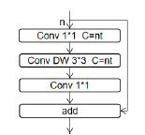
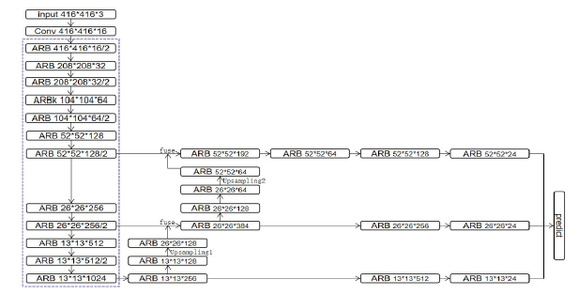
Xiaotian Gonga , Li Mab and Hangkong Ouyang An improved method of Tiny YOLOV3
Improved YoloTinyV3 Model

Slide 19
Speed Improvement :
Future Step , increase the speed of model using pruning techniques

Slide 20
Gan for Data Generation :
Time Consuming but may offer better results.
Comparative analysis of GAN DataGeneration and synthetic image generation.

Slide 21
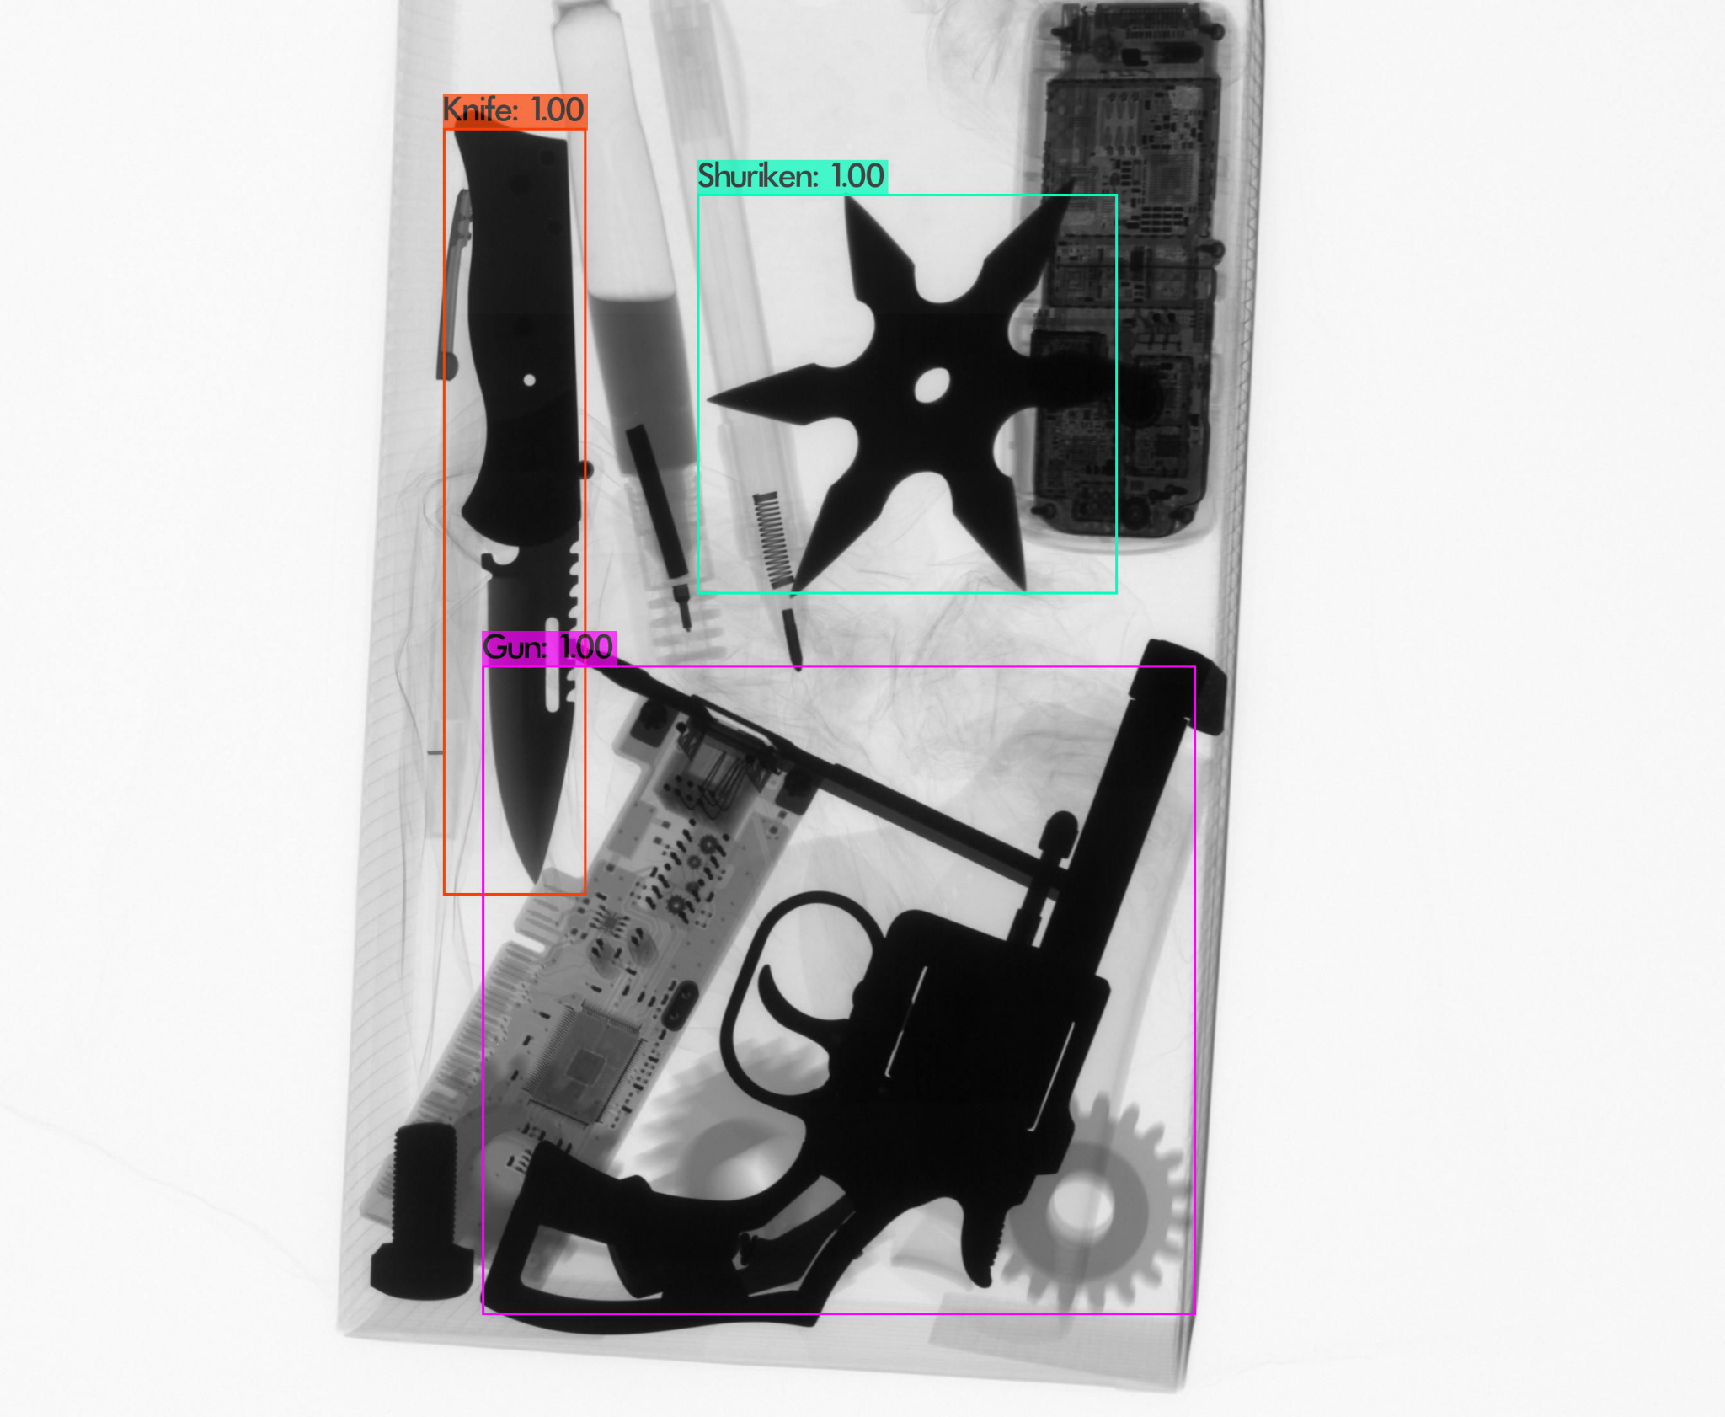
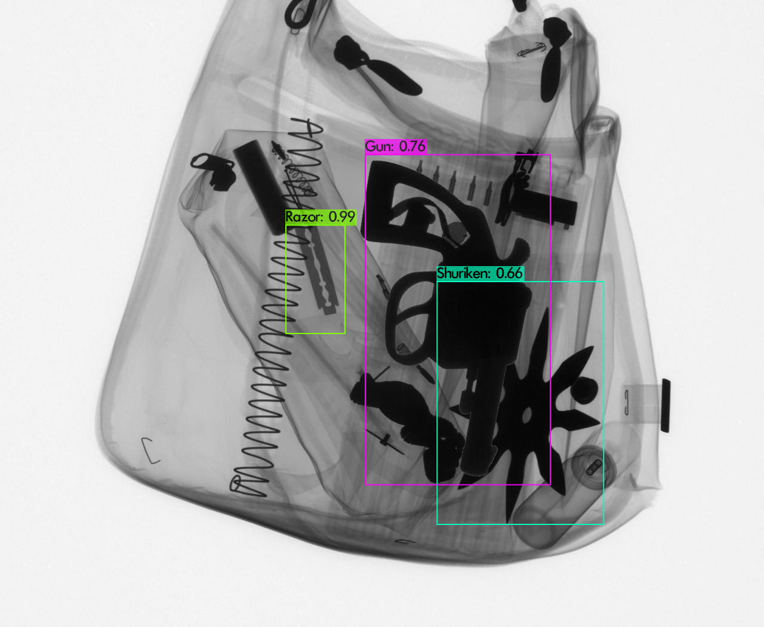
Sample Results :

Slide 22
Summary and Discussion?
Train the model on new objects
Good accuracy for gun data
Add Diversity & Save Human Cost
Smaller Objects improving or changing yolov3-tiny model may give some accuracies
Increase synthetic train dataset from 100 to 500, increases accuracy from 8.1% to 12%
Need further analysis on real data & synthetic data
Limitation single background/target image and few threat images per classes.
Compare GANS and Synthetic Data Creation Approach

Slide 23
Questions?

